Slide 1
Introduction to RNN

Slide 2
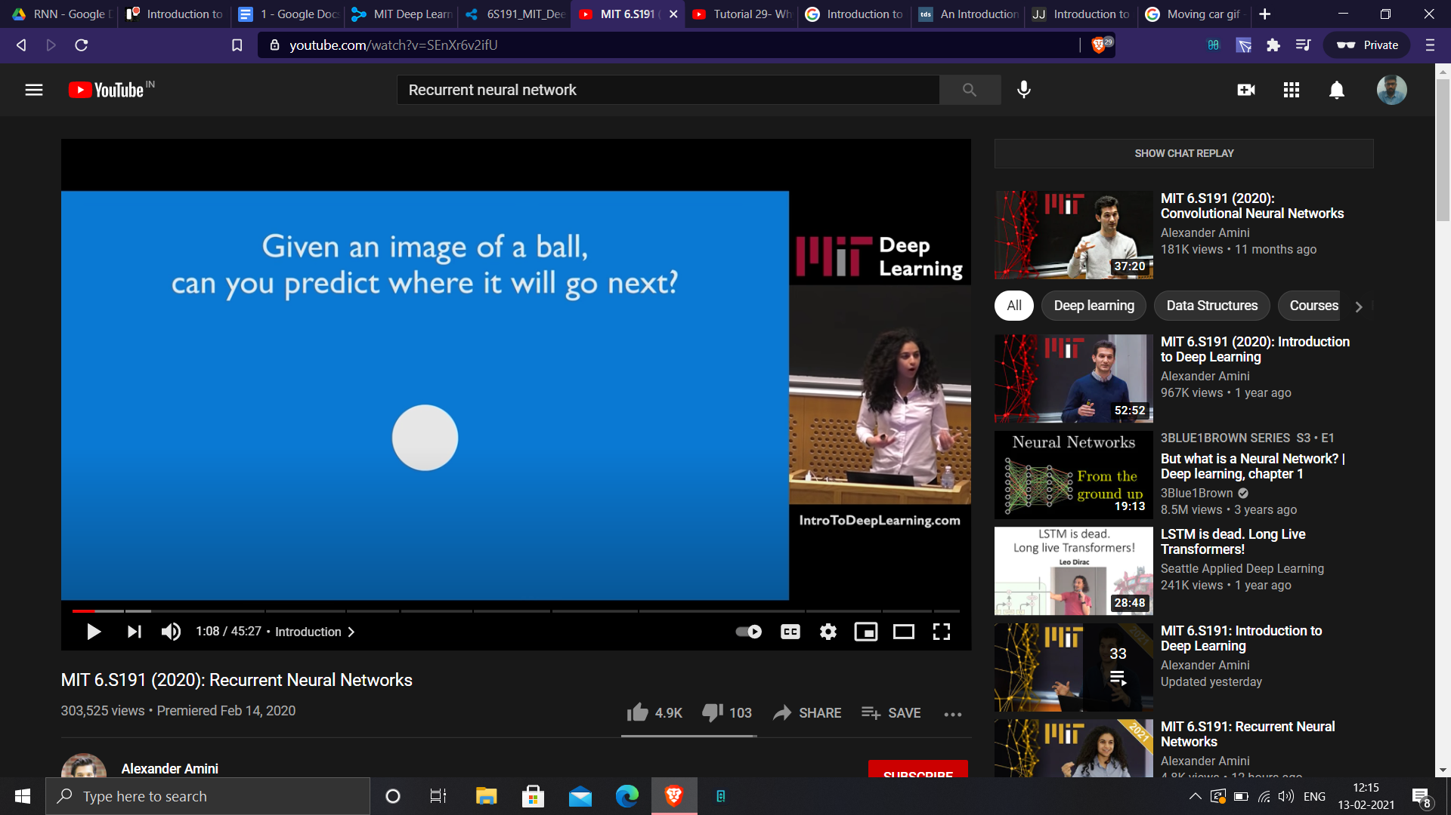

Slide 3
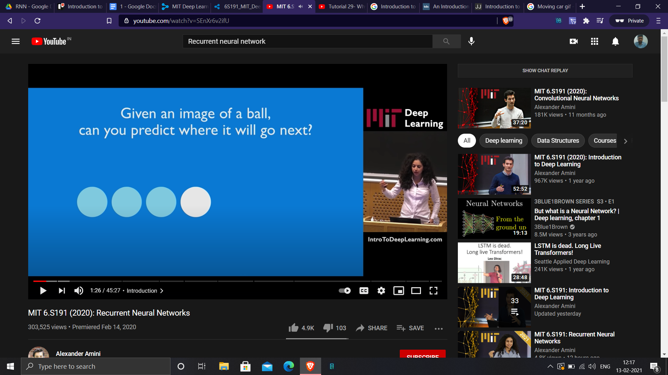

Slide 4
Example problem statements
Text Generation
Sequence Classification
Language Translation
Signal processing and a lot more
Parts of Speech recognition

Slide 5

Why not ANN or CNN ?
With continuously generated text, the size of Input dynamically changes
neural networks only input a fixed dimension data

Slide 6
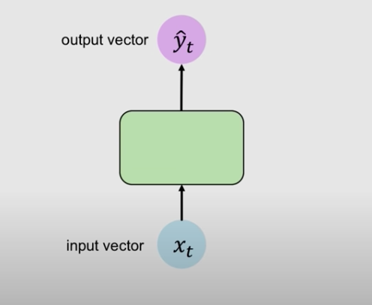
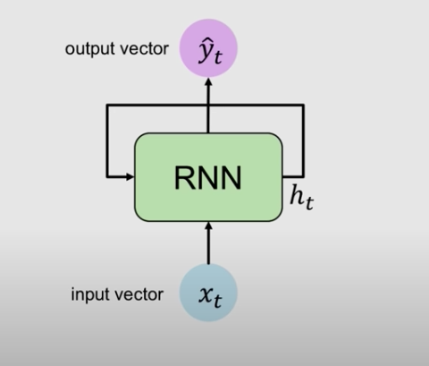
ANN vs RNN

Slide 7
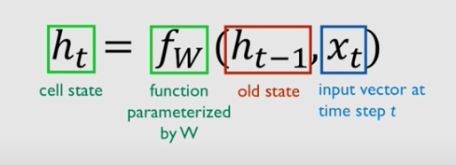
Hidden state update
State update is based on Previous hidden state h(t-1) and Current Input vector x(t)

Slide 8
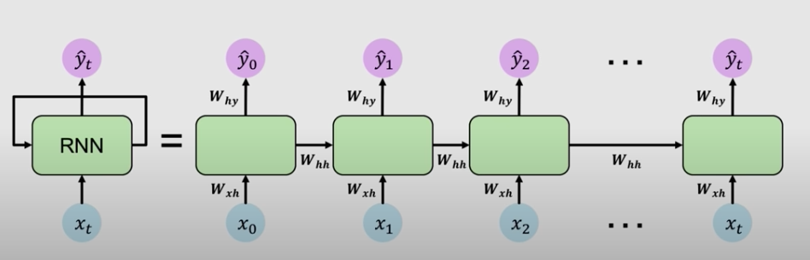
Expand Recurrence
W(xh) - weights between the Input vector and the hidden state
W(hh) - weights between hidden state timesteps
W(hy) - between the hidden state and output vector

Slide 9
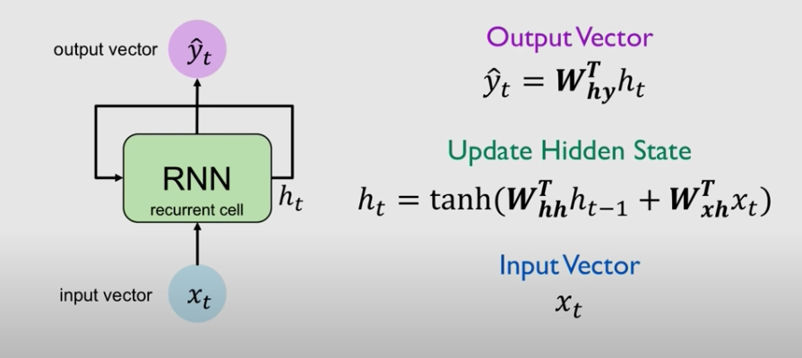
Formulated Hidden state update
Weight affecting hidden state are W(xh) and W(hh)

Slide 10
Vanishing and Exploding Gradients

Slide 11
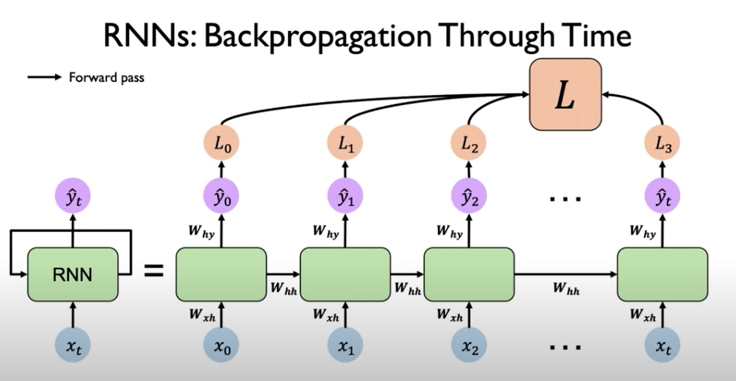
Backpropagation in RNN
Forward pass in RNN moves forward across time while updating the hidden state based on previous hidden and current input.
It generates Output at every step i.e.., it calculates the loss at each timestep.
3. All Individual losses are aggregated to form a total loss of network
4. Errors flow back in time from our current time step x(t) to first time step x(0).

Slide 12
Issues with BPTT
When performing backpropagation through time, Network performs a lot of matrix operations involving weight matrix W(hh).
Computing gradients in 1st time step h(0) involves many factors of weight matrix W(hh) and repeated gradient computations of h(t) to h(1).
This can Lead to Two problems
Exploding Gradients
Vanishing Gradients

Slide 13
Exploding Gradients
If gradient value > 1 in series of multiplications, then there is a chance for gradients to explode while backpropagation.
Example :
1 power 100 = 13780.61, while 1 power 100 = 1.
Solution :
Gradient Clipping
where we scale down large values to less than 1.

Slide 14
Vanishing Gradients
If gradient value < 1 in series of multiplications, then there is a chance for gradients to vanish while backpropagation.
Example :
0.9 power 100 = 0.0000265 while 1 power 100 = 1.
Solution :
Choosing good activation functions
Better weight initializations
Changing network architecture

Slide 15
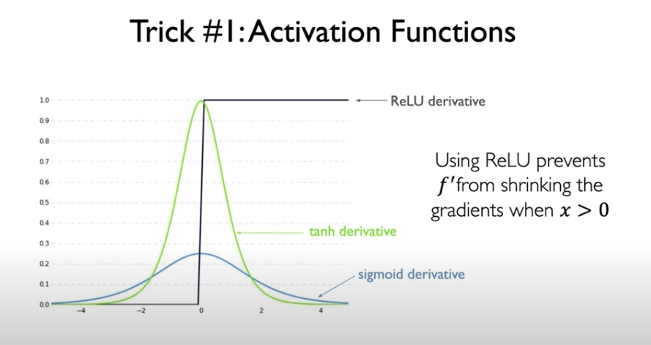
Choosing Good Activation Function
ReLu and its variants are good when it comes to gradient flow

Slide 16
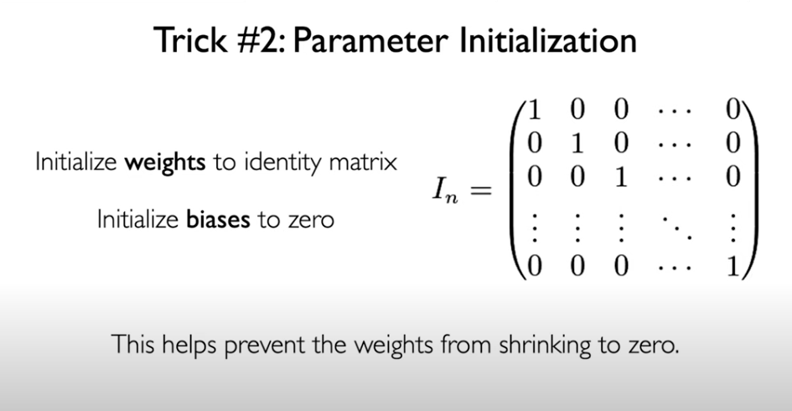
Weight Initialization

Slide 17
Introduction to LSTMs

Slide 18
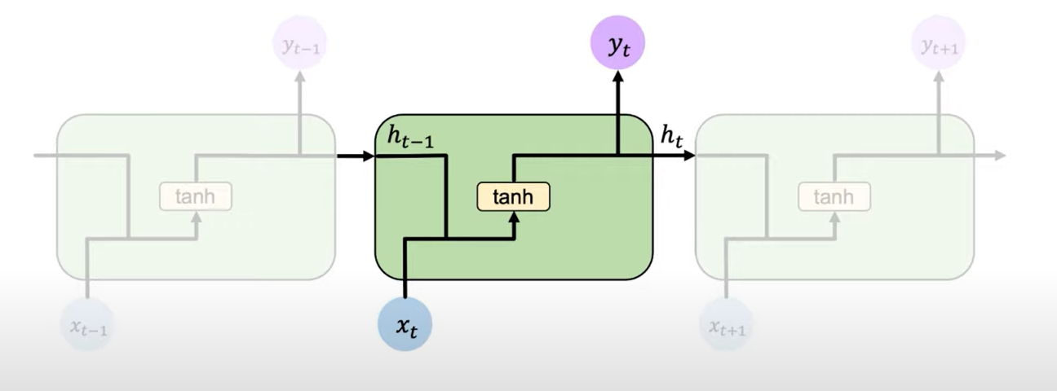
Standard RNN Cell

Slide 19
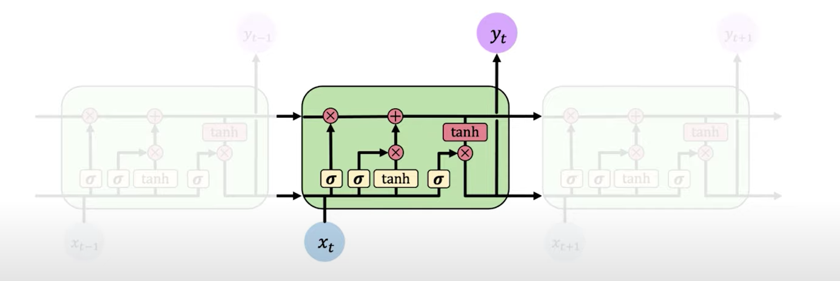
Long Short Term Memory Unit
Recurring structure with the recurrent unit being slightly complex.
LSTM cell contains neural network operations like applying Sigmoid , Tanh and weight multiplications used to control the flow of information moving forward in the network.

Slide 20
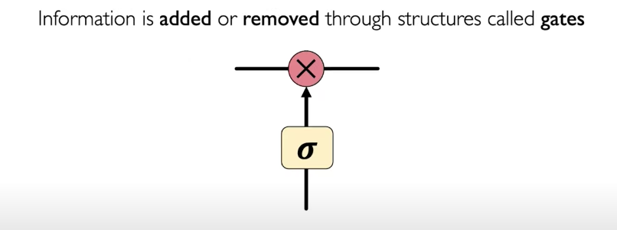
Gate
Gates help in adding or removing information to the internal cell state.
Applies Sigmoid function
Force anything passing through the gate to be between 0 and 1.

Slide 21
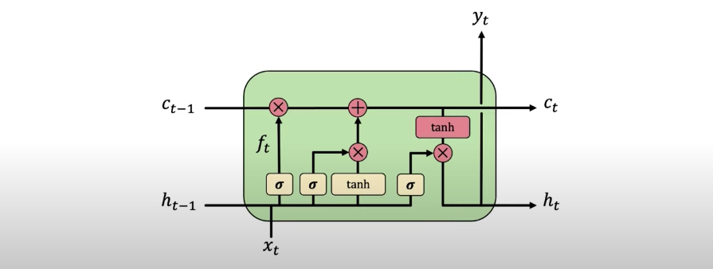
Operations in LSTM
There are four main operations in an LSTM cell,
Forget
Store
Update
Output

Slide 22
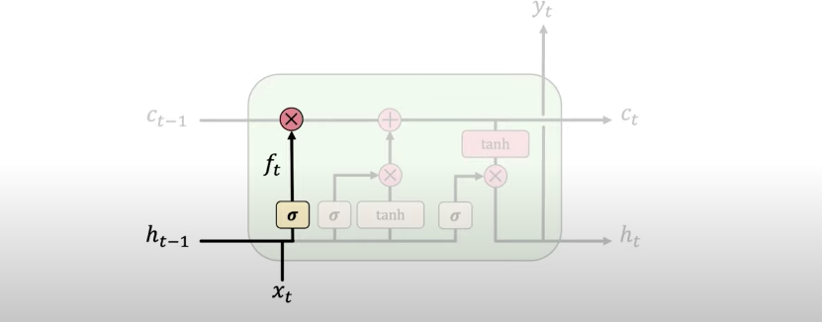
Forget
Forgets irrelevant parts of the previous state by passing the previous state to one of the sigmoid function.

Slide 23

Store
Determines what part of the old information is relevant and stores it into the cell state.

Slide 24

Update
Apart from hidden state, LSTM also maintains a separate cell state c(t).
C(t) is updated by these Gate operations, In a good case these gate operations can allow complete cell state to pass to the next cell.

Slide 25
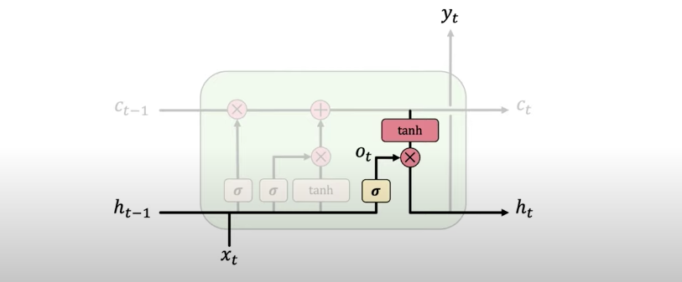
Output
Output gate controls the information that has to be sent into the next cell.

Slide 26
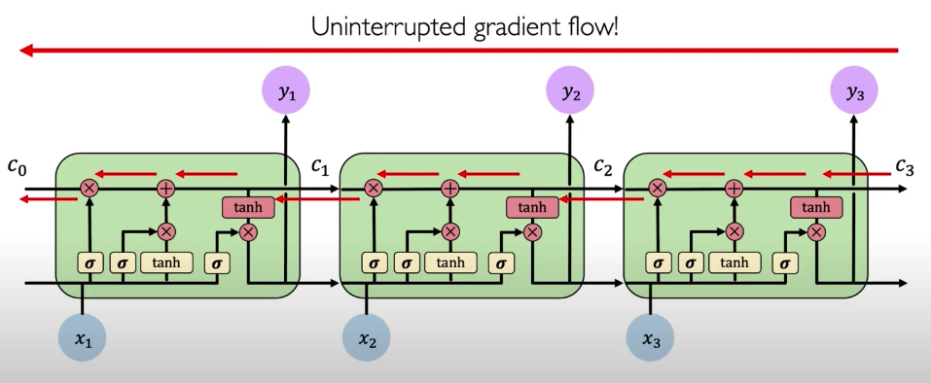
Advantages
LSTM regulates information flow and storage using which it captures better long term dependencies.
“Uninterrupted gradient flow” while performing backpropagation through time.

Slide 27
BiDirectional Networks

Slide 28
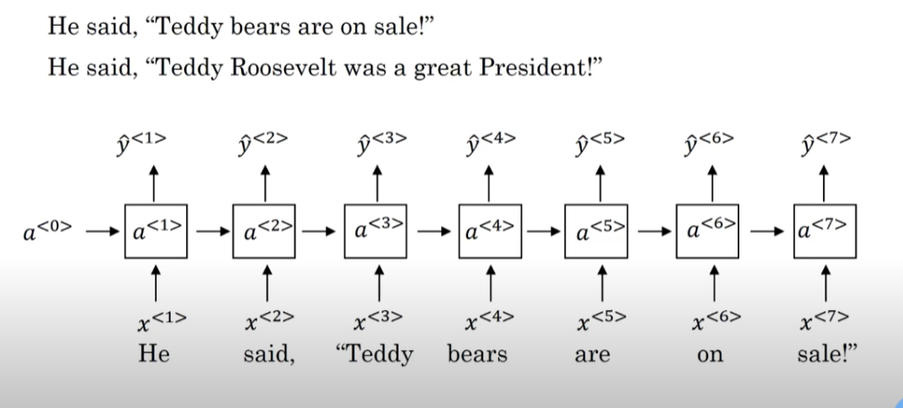
Issue with Single Direction Networks
Suppose we are trying to build an “Entity Recognition” system which can classify the words into entities like “Location”, “Name of Person” or “Object” etc..

Slide 29
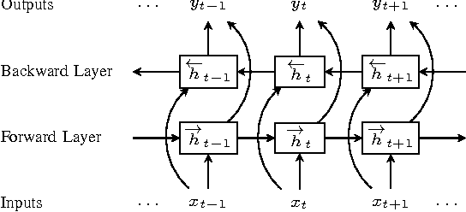
Bi Directional Network
First, network computes the forward layers hidden states
Next, It computes the backward layers hidden state for the latest time step to beginning.

Slide 30
Bi Directional Networks
The prediction at timestep y(t) is a function of forward hidden state h(forward)(t) and backward hidden state h(backward)(t).
BiDirectional variants of LSTMs are commonly used by many companies in solving NLP problem statements.

Slide 31
Industry Relevance of RNN

Slide 32
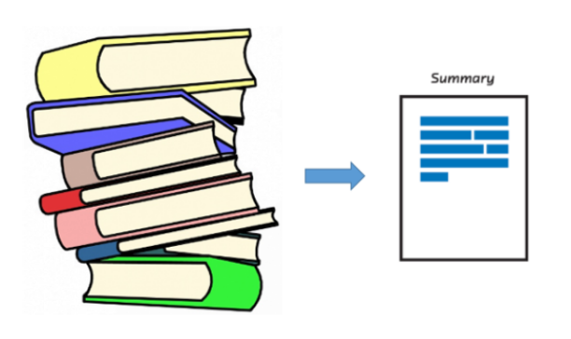
Text Summarization
Helpful in Summarizing content from any literature and optimize for delivery within software applications not built to render large volumes of text.

Slide 33
Text recommendation

Slide 34

Language Translation
Convert Text and Voice from one language to another

Slide 35

Speech Recognition
Speech as a sequential input of frequency with a certain pitch and modulation
sequence models can be used for detecting the patterns in these sequences to predict whether its known or unknown voice.

Slide 36

Time Series Predictions
Time series prediction problem statements involve predicting the next state given the historic information.

